Slide 1
Network Topology
Presented by
Muhammad Ali
ID 1204692

Slide 2
Network Topology
Topology means which is the method of establishing connection with Network.

Slide 3
Type of network topology
There are several kinds of topology such as Bus Star Ring Mesh Point-to-point Point-to-multipoint Hybrid

Slide 4
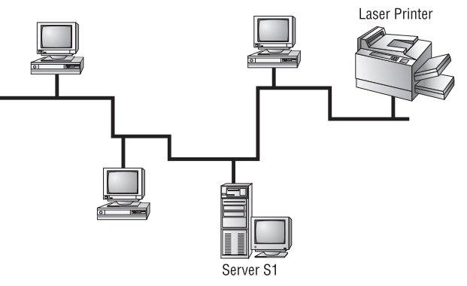
Bus Topology
Bus topology is which connects each computers to another computer with one unbroken cable running its entire length. Bus topology attach computers to that main cable with wire taps, but this didn’t work all that well so we began using drop cables in their place.
Advantage:Some of the benefis in favor of using a bus topology are that it’s easy to install and it’s not very expensive, in part because it doesn’t require as much cable as the other types of physical topologies.

Slide 5
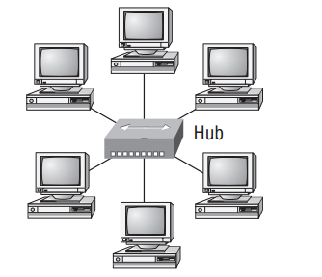
Star Topology
A star topology’s computers are connected to a central point with their own individual cables or wireless connections. You’ll often fid that central spot inhabited by a device like a hub, a switch, or an access point. Advantage:Star topology offers a lot of advantages over bus topology, making it more widely used even though it obviously requires more physical media. One of its best features is that because each computer or network segment is connected to the central device individually, if the cable fails, it brings down only that particular machine or network segment.

Slide 6
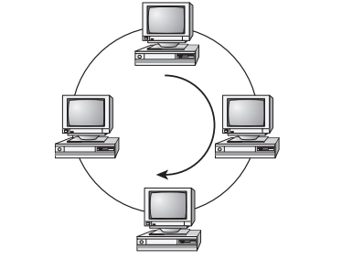
Ring Topology
Ring topology means which computer is directly connected to other computers within the same network. Ring topology is the same as bus topology because if cable ring breaks the entire network breaks down.

Slide 7
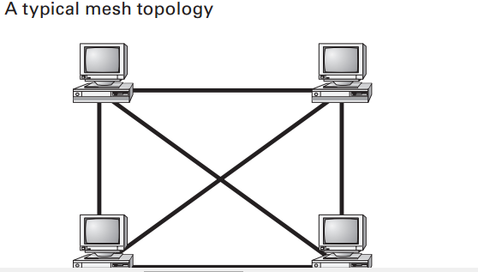
Mesh Topology
Mesh topology means which connects most physical connections per device In this type of topology, thereis a path from every machine to every other one in the network.

Slide 8
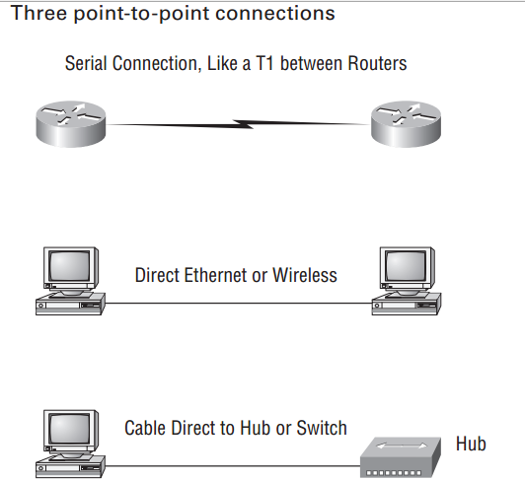
Point-to-Point Topology
Point-to-point topology reffers which directy connects between tworouters, giving you one communication path. A. The routers in a point-to-point topology can either be linked by a serial cable, making it a physical network, or be far apart and connected B. Part two of the diagram shows two computers connected by a cable—a point-to-point link.

Slide 9
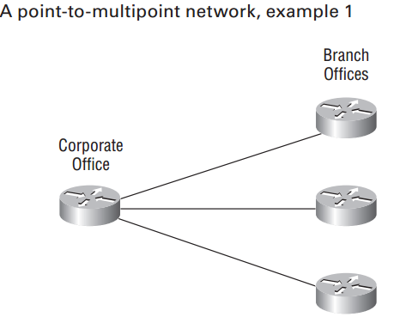
Point-to-Multipoint Topology
A point-to-multipoint topology means which connections between an interface on one router and multiple destination routers—one point of connection to multiple points of connection. Each of the routers and every one of their interfaces involved in the point-to-multipoint connection are part of the same network.

Slide 10
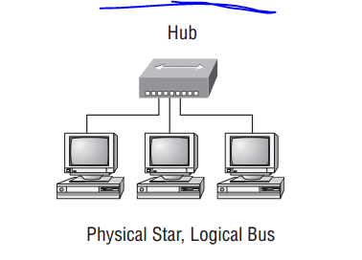
Hybrid Topology
Hybrid topology means which is combination of two or more types of physical or logical network topologies working together within the same network.

Slide 11
Thank you
For watching this presentation

